Slide 1
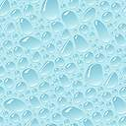
Hardness of Water

Slide 2
Learning outcomes
Student Should be able to
Define hardness of water
Know the types of hardness in water
Calculate Calcium carbonate equivalent of hardness
Know units of hardness and their relation

Slide 3
Hardness of Water
Hard water: Water consisting of dissolved salt of Calcium and Magnesium is called as hard water.
Actually hardness is a comparative terminology based concentration of Calcium and Magnesium ions
Soft | 0 - 17.1 ppm
Slightly hard | 17.1 – 60 ppm
Moderately hard | 60 - 120 ppm;
Hard | 120 - 180 ppm
Very hard | 180 ppm or more

Slide 4
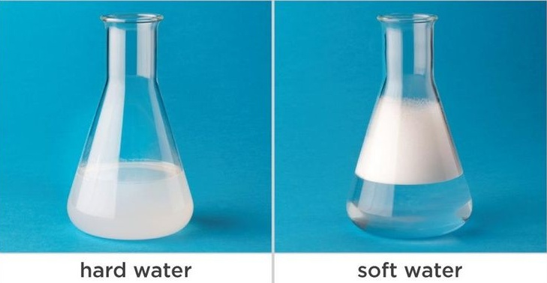
Hardness of Water
Soft water: Easily produce lather with soap.
Hard water: Does not produces lather with soap but leads to formation of scum.
Why?
C₁₇H₃₅COONa + H₂O C₁₇H₃₅COO⁻ + NaOH

Slide 5
Hardness of Water
Hence, Hardness is the property of water by which it prevent formation of lather with soap.
Mainly due to presence of Calcium and Magnesium salt in water e.g.Ca(HCO₃)₂, Mg(HCO₃)₂, CaSO_{4,} MgSO₄,
Ca(NO₃)₂, Mg(NO₃)₂ etc.
Types of Hardness
Depending the type of salt present in water hardness can be classified in two types
1)Temporary Hardness 2) Permanent Hardness

Slide 6
Types of Hardness
1) Temporary hardness (or) Carbonate hardness:
Ca(HCO₃)₂ CaCO₃ + H₂O + CO₂
Mg(HCO₃)₂ Mg(OH)₂ + 2CO₂
Bicarbonates of Ca and Mg can be easily removed by boiling the water and filtration hence called as temporary hardness.
2) Permanent hardness (or) Non-carbonate hardness:
Can not be easily removed by boiling and filtration.
e.g. chlorides and sulphates of Ca and Mg.
Removed by: lime soda, zeolite process etc.
Heat
Heat

Slide 7
Hardness of water
Total Hardness
= Temporary Hardness + Permanent Hardness
Hardness is expressed in terms of CaCO₃ equivalent
Why only CaCO₃ equivalent ?
Molecular weight is 100 (equivalent wt. = 50)
CaCO₃ is most insoluble salt that can be precipitated in water treatment.
CaCO₃ equivalent of a
Hardness causing salt
Mass of hardness
Producing salt
Chemical equivalent of CaCO₃
X
=
Chemical equivalent of hardness causing salt

Slide 8
Calculation of CaCO₃ equivalent
Dissolved Salt | Molecular Mass | Chemical equivalent | Multiplication factor
Ca(HCO₃)₂ | 162 | 81 | 100/162
Mg(HCO₃)₂ | 146 | 73 | 100/146
CaCO₃ | 100 | 50 | 100/100
MgCO₃ | 84 | 42 | 100/84
CaSO₄ | 136 | 68 | 100/136
MgSO₄ | 120 | 60 | 100/120
CaCl₂ | 111 | 55.5 | 100/111
MgCl₂ | 95 | 47.5 | 100/95
Ca(NO₃)₂ | 164 | 82 | 100/164
Mg(NO₃)₂ | 148 | 74 | 100/148
CaCO₃ equivalent = Mass of Hardness producing salt X multiplication factor

Slide 9
Units of Hardness
Parts per million (ppm)
Parts of CaCO₃ equivalent of hardness causing salt per million (10⁶) parts of water.
Hence 1 ppm = 1 part CaCO₃ equivalent of hardness causing salt per million part of water.
Parts per billion (ppb)
Parts of CaCO₃ equivalent of hardness causing salt per billion (10⁹) parts of water.
Hence 1 ppb = 1 part CaCO₃ equivalent of hardness causing salt per billion part of water.

Slide 10
Units of Hardness
Degree French (˚ fr)
Parts of CaCO₃ equivalent of hardness causing salt per 10⁵ parts of water.
Hence 1 ˚ fr = 1 part CaCO₃ equivalent of hardness causing salt per 10⁵ parts of water.
Clarke’s degree (˚ Cl)
Parts of CaCO₃ equivalent of hardness causing salt per 70,000 parts (per gallon)of water.
Hence 1 ˚ Cl = 1 part CaCO₃ equivalent of hardness causing salt per 70,000 parts (per gallon)of water.

Slide 11
Units of Hardness
Milliequivalent per liter (meq/L)
Number of CaCO₃ equivalent of hardness causing salt per liter of water.
Hence 1 meq/L = 1 meq of CaCO₃ hardness per liter of water.
Milligram per liter (mg/L)
Number of milligrams of CaCO₃ equivalent of hardness causing salt per liter of water.
Hence 1 mg/L = 1 mg of CaCO₃ hardness per liter of water.

Slide 12
Summary
Definition of Hardness?
Types of Hardness?
CaCO₃ equivalent of Hardness?
Units of Hardness?

Slide 13
Thank You

